Slide 1

editandprint
www.editandprint.com.au

Slide 2
About
Edit and Print is a partnership between IBS Cards, one of Australia’s largest trade printers and 44 Gallons Technology Pty Ltd, an Australian technology innovator and developer of web to print technology.
As an Edit and Print affiliate you will be part of this innovative partnership, taking your business to the next level, gaining the rewards of utilizing best in class technology.
Edit And Print Pty Limited
8/12 Lawrence Drive Nerang
Queensland, Australia 4211

Slide 3
Plans
Essential ($125AUD monthly)
Premium ($450aud monthly)
Your own branded online shop
Set your own prices
Send orders to Printer of choice.
Add your own products.
Facebook Integration.
Dynamic CMS.
Ability to manage Corporate Clients.
Opportunity to upgrade at any time to include editor
Easy to use editor – Give your customer control over their print
Demonstrable productivity saving
Design Template Store
Ability to send orders to Printer of choice
Access to both flex editor and PDFlib editor
Add your own products
Create your own templates
Dynamic CMS
Ability to manage Corporate Clients

Slide 4
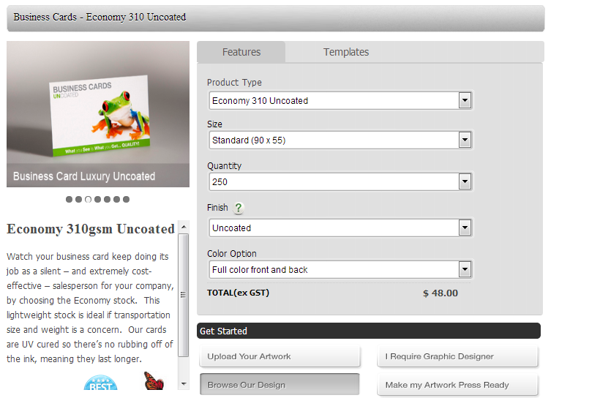
Ordering
Prices are calculated automatically based on the selected item options

Slide 5
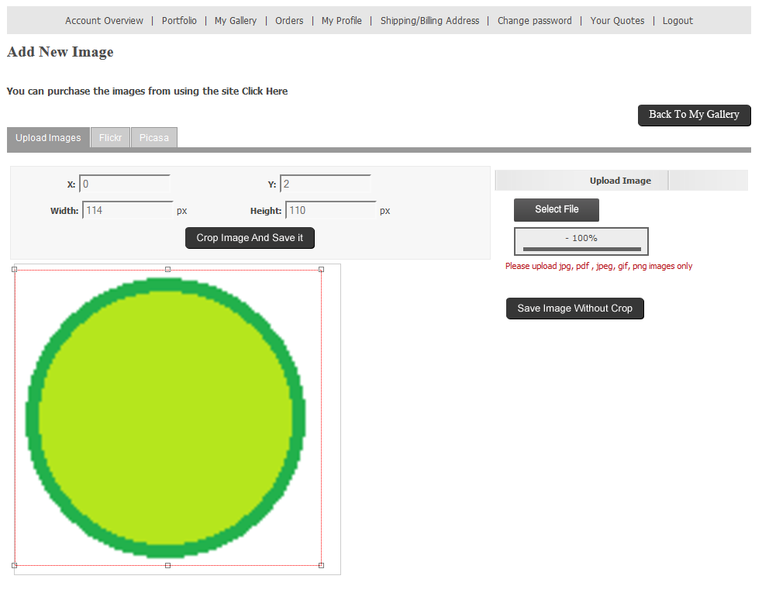
Upload Design
Customers can upload their own design in PDF or image formats or upload directly from Flickr or Picasa.

Slide 6
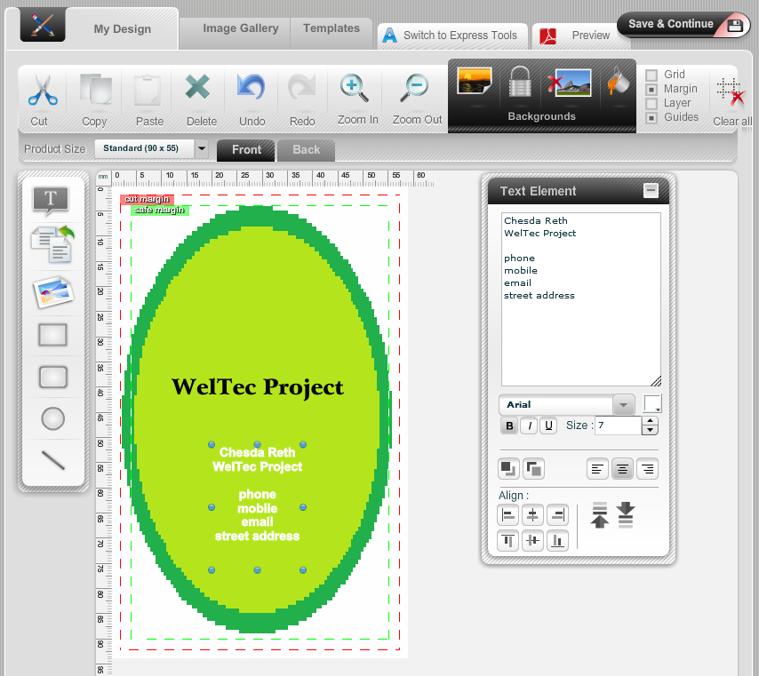
Designer Studio (premium plan)
Customers can design their own template or edit a supplied template for every item.

Slide 7
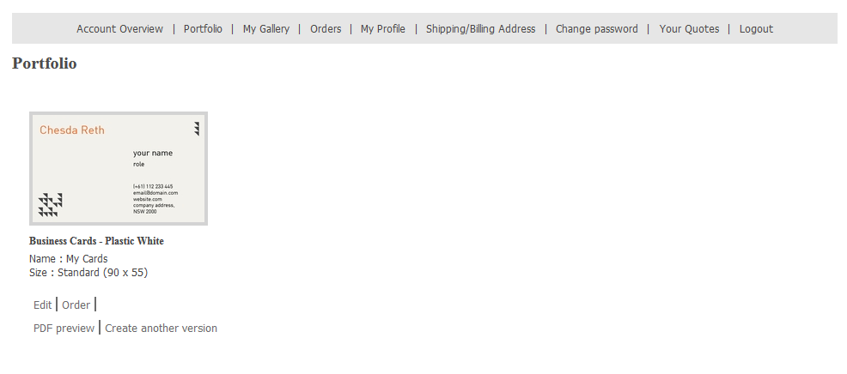
Customer Portfolio
Customer’s designs are saved in their portfolio and can be reordered, edited and previewed,

Slide 8
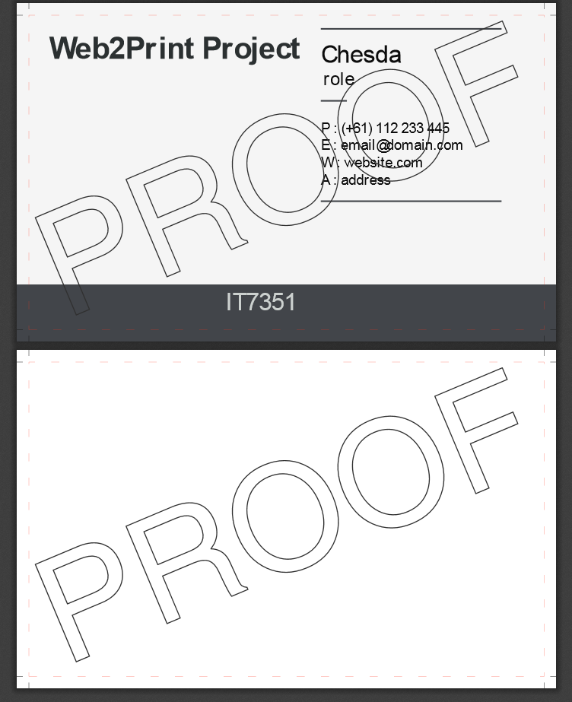
Proofing
Customers can preview their print ready artwork in PDF format. Cut lines are present (not sure if you can custom set these)

Slide 9
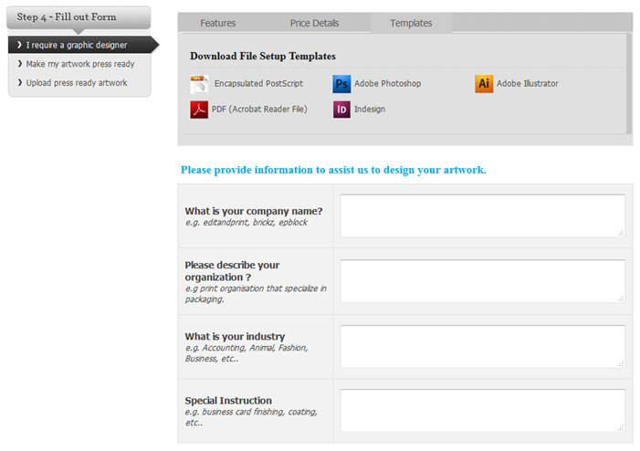
Design Assistance
Customers can request help from a graphic designer and upload image of sketches/logo. Progress is tracked in the Quotes history.

Slide 10
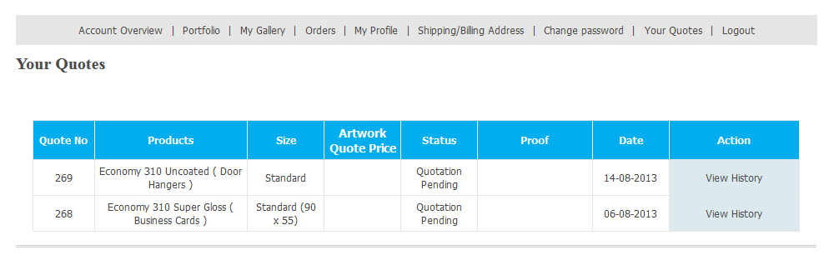
Order and Quote History
Quote status, price, and proofing can be viewed in the Customer History.

Slide 11
Strengths
Online Editor (premium plan)
Quote progress tracking
Covers 83% of Functional Requirements
Covers 90% of General Requirements
User friendly front shop
User friendly admin control panel

Slide 12
Weaknesses
Credit Card is the only payment option
Customers cannot cancel or change quotes
Online Editor needs Flash Player to run (may not be compaitable with some browsers)
Costs –Setup fees, Training is mandatory

Slide 13
Cost
Essential
Premium
$125 AUD monthly
$1250 activation and setup fees
$750 training (mandatory)
$450 AUD monthly
$2500 activation and setup fees
$1000 training (mandatory)

